Slide 2
set up your development environment setup .
go over HTML5 basic .

Slide 3
Do you realize ?
Do you realize that the only functionality of a web application is that the user directly interacts with is through the web page? If Implement it poorly and, to the user, the server-side becomes irrelevant!
Today’s user expects a lot out of the web page: it has to load fast, expose the desired service, and be comfortable to view on all devices: from a desktop computers to tablets and mobile phones

Slide 4
Do you realize ?
Do you realize that the only functionality of a web application that the user directly interacts with is through the web page? Implement it poorly and, to the user, the server-side becomes irrelevant!
Today’s user expects a lot out of the web page: it has to load fast, expose the desired service, and be comfortable to view on all devices: from a desktop computers to tablets and mobile phones.

Slide 5
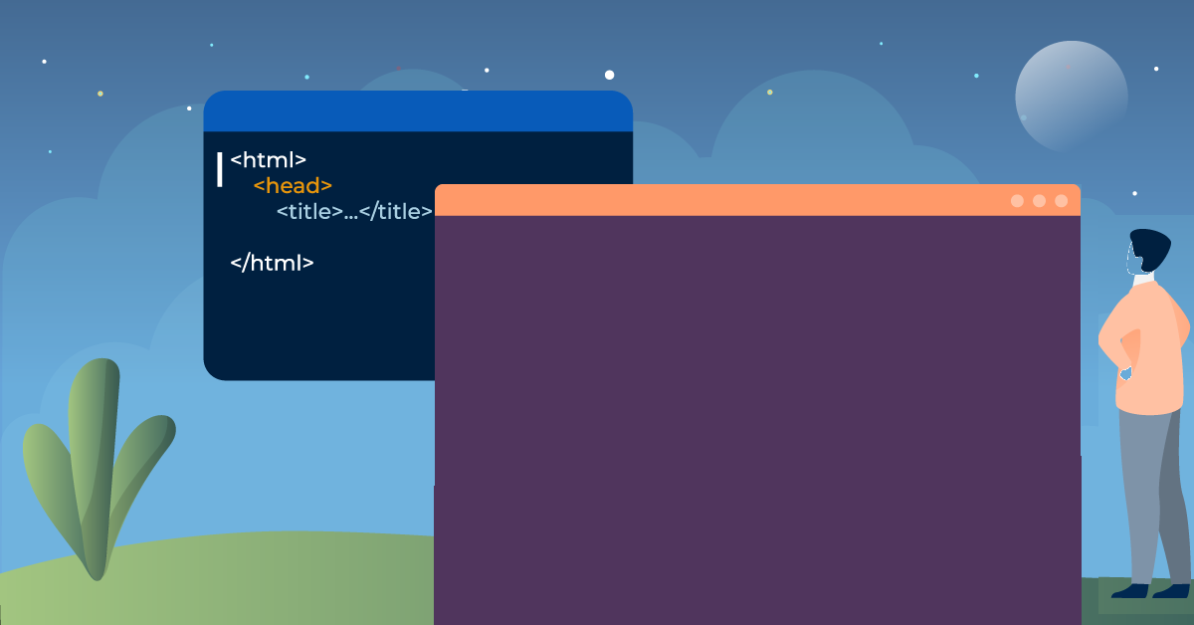
Why to learn html?
Create Web site - You can create a website or customize an existing web .
Become a web designer - If you want to start a carrier as a professional web designer.
Understand web - If you want to optimize your website, to boost its speed and performance.
Learn other languages - other related technologies like javascript , php, or angular are become easier to understand.

Slide 6
What is HTML5 ?
HTML5 is a markup language used for structuring and presenting content on the World Wide Web.
It is the fifth and last major HTML version that is a World Wide Web Consortium (W3C) recommendation.

Slide 7
How do I setup my HTML/CSS environment?
HTML coding can be written in basic text editor and that are just viewed by any web browser. They don't act like other conventional programming languages which are compiled into machine code.

Slide 8
How do I setup my HTML/CSS environment?
HTML and CSS can be written in anything - even as basic as notepad. These are grouped as "text editors" and can be powerful and help your workflow if you master one. The most important thing is to find an environment which is comfortable for you.

Slide 9
How do I setup my HTML/CSS environment ?
The main ones in order to benefit workflow are Sublime Text and Notepad++. Both have great plugins and themes available to it, but Notepad++ is only available on Windows, where as Sublime Text is cross platform.

Slide 10
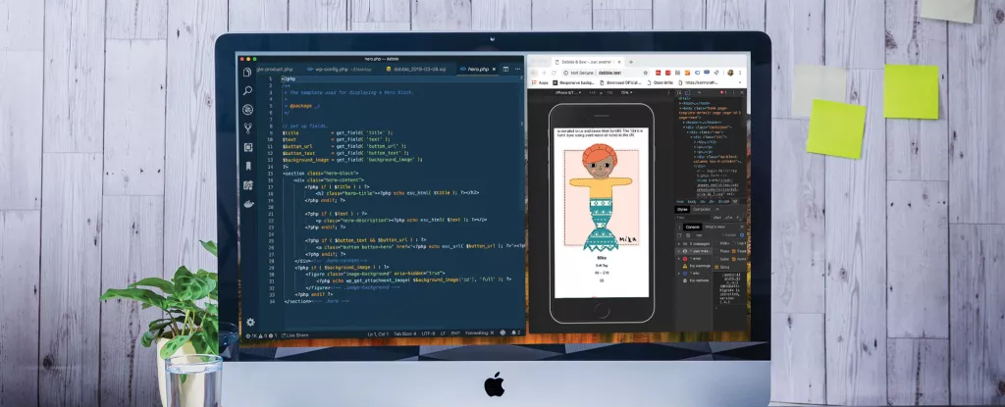
HTML & CSS Local Environment Setup
The Text Editor.
Browser Setup.
Your Working Folder.
Creating an HTML File.

Slide 11
HTML & CSS Local Environment Setup (Windows)
Generally, it's called local development when you create and test a website using only your own computer. The setup required is called local environment setup. After you have set up your local development environment, you can work on creating your own website with HTML & CSS anytime and anywhere (even without an internet connection).
What you need: • A computer • Basic HTML & CSS skills

Slide 12
1. The Text Editor
The two most essential tools for developing a website are a text editor and a browser. We'll start by choosing and setting up a text editor. A text editor (or just "editor") is like the window in the center of every lesson where you write your code.

Slide 13
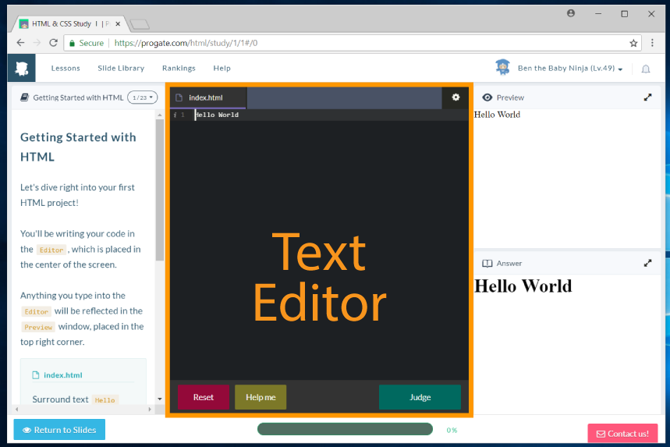
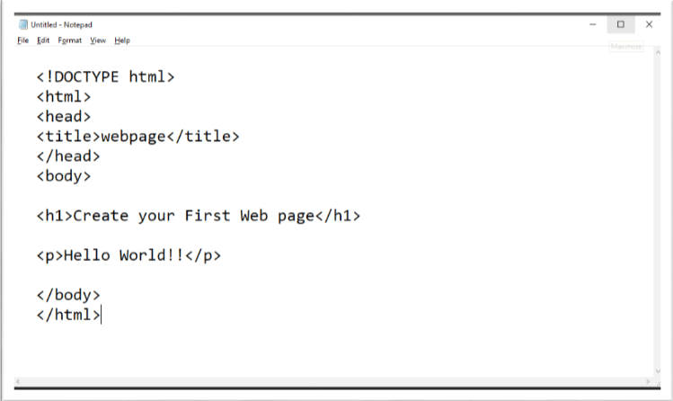
Text Editor

Slide 14
HTML Text editor
An HTML editor is a program for editing HTML, the markup of a web page. Although the HTML markup in a web page can be controlled with any text editor, specialized HTML editors can offer convenience and added functionality.

Slide 15
Browser Setup
Browsers are for viewing and displaying websites .There is a window on the right where the result of your HTML & CSS code is displayed so you can see if it's correct.

Slide 16
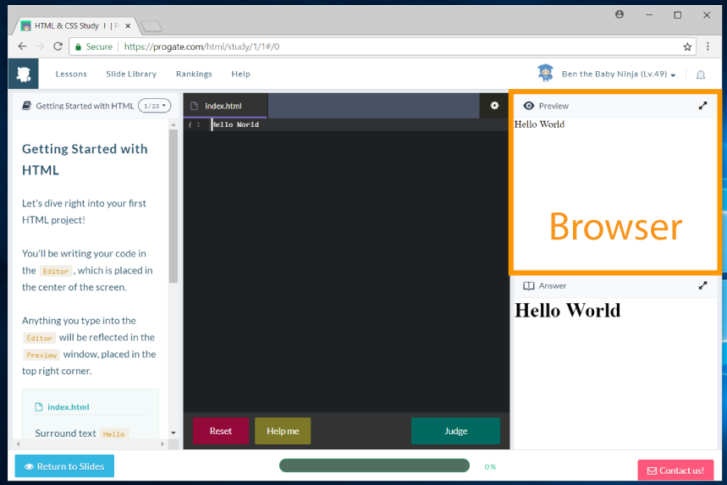
2. Browser Setup

Slide 17
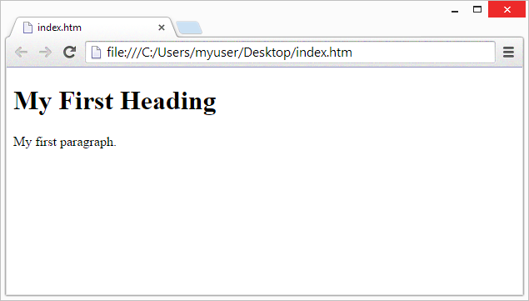
Browser Display

Slide 18
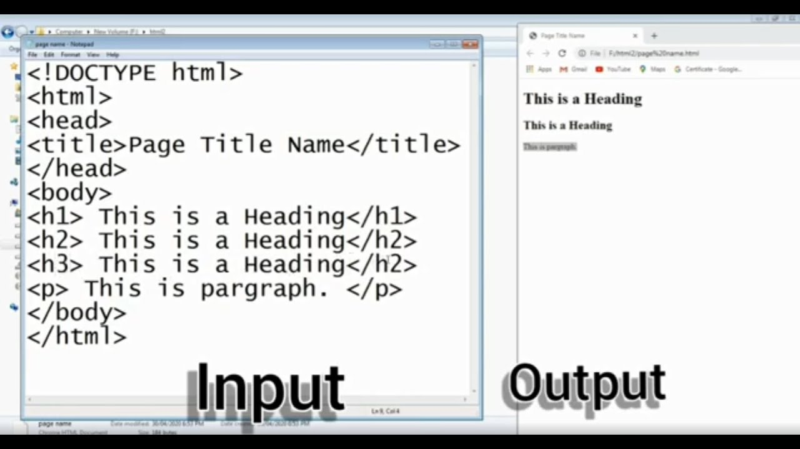
Input/Output

Slide 19
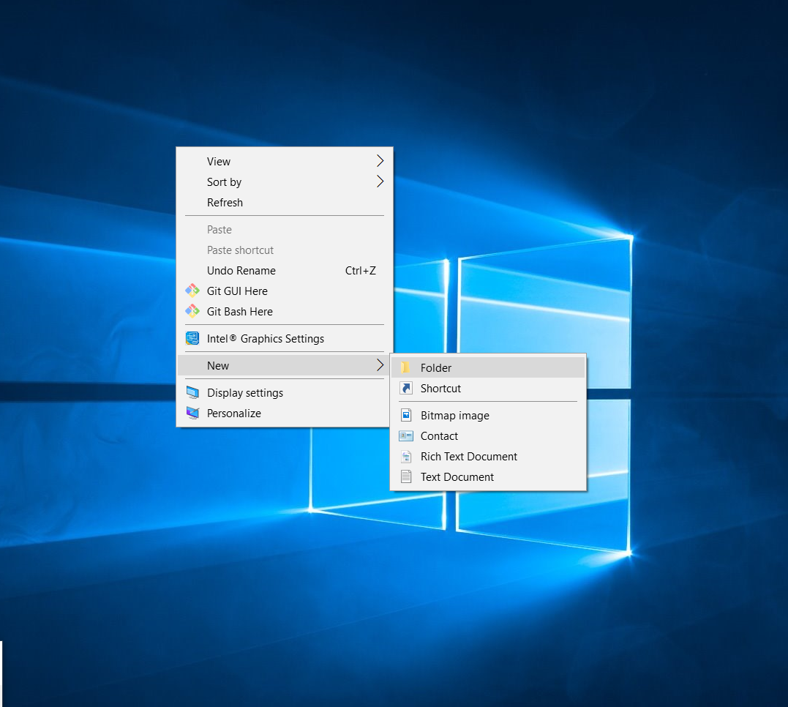
3. Your Working Folder

Slide 20
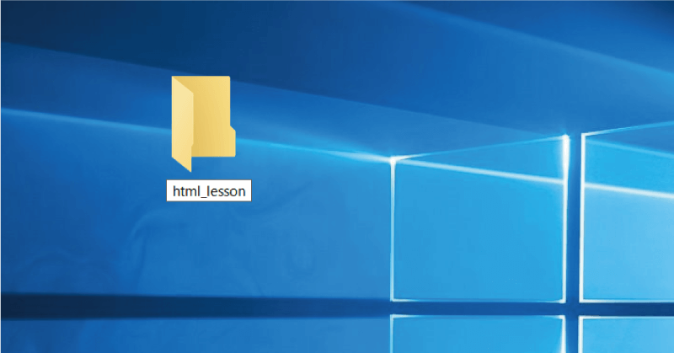
Let's name the folder html_lesson.

Slide 21
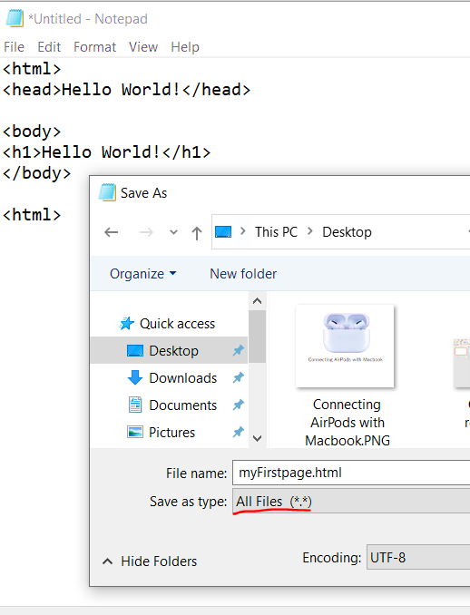
4. Creating an HTML File

Slide 22

Tags
“Normal text” surrounded by bracketed tags that tell browsers how to display web pages.
Pages end with “.htm” or “.html”
HTML Editor – A word processor that has been specialized to make the writing of HTML documents more effortless.
Notes:
09/22/97
3
University of Minnesota Extension Service
Master Internet Volunteer Program
Provide information in an organized way
Chat Groups
Specialized information areas
Internet access

Slide 23
Choosing Text Editor
There are many different programs that you can use to create web documents.
HTML Editors enable users to create documents quickly and easily by pushing a few buttons. Instead of entering all of the HTML codes by hand.
These programs will generate the HTML Source Code for you.

Slide 24
Choosing Text Editor
There are many different programs that you can use to create web documents.
HTML Editors enable users to create documents quickly and easily by pushing a few buttons. Instead of entering all of the HTML codes by hand.
These programs will generate the HTML Source Code for you.

Slide 25
Choosing Text Editor
There are many different programs that you can use to create web documents.
HTML Editors enable users to create documents quickly and easily by pushing a few buttons. Instead of entering all of the HTML codes by hand.
These programs will generate the HTML Source Code for you.

Slide 26
Choosing Text Editor
HTML Editors are excellent tools for experienced web developers; however; it is important that you learn and understand the HTML language so that you can edit code and fix “bugs” in your pages.
For this Course, we will focus on using the standard Microsoft Windows text editors, NotePad.

Slide 27
Choosing Text Editor
HTML Editors are excellent tools for experienced web developers; however; it is important that you learn and understand the HTML language so that you can edit code and fix “bugs” in your pages.
For this Course, we will focus on using the standard Microsoft Windows text editors, NotePad.

Slide 28
Starting note pad
NotePad is the standard text editor that comes with the microsoft windows operating system. To start NotePad in windows follow the steps bellow:
Click on the “Start” button located on your Windows task bar.
Click on “Programs” and then click on the directory menu labeled “Accessories”.
Locate the shortcut “NotePad” and click the shortcut once.

Slide 29
Starting note pad
NotePad is the standard text editor that comes with the microsoft windows operating system. To start NotePad in windows follow the steps bellow:
Click on the “Start” button located on your Windows task bar.
Click on “Programs” and then click on the directory menu labeled “Accessories”.
Locate the shortcut “NotePad” and click the shortcut once.

Slide 30
Starting note pad
NotePad is the standard text editor that comes with the microsoft windows operating system. To start NotePad in windows follow the steps bellow:
Click on the “Start” button located on your Windows task bar.
Click on “Programs” and then click on the directory menu labeled “Accessories”.
Locate the shortcut “NotePad” and click the shortcut once.

Slide 31
Starting note pad
NotePad is the standard text editor that comes with the microsoft windows operating system. To start NotePad in windows follow the steps bellow:
Click on the “Start” button located on your Windows task bar.
Click on “Programs” and then click on the directory menu labeled “Accessories”.
Locate the shortcut “NotePad” and click the shortcut once.

Slide 32
Creating a Basic Starting Document
<HTML>
<HEAD>
<TITLE>Latest news </TITLE>
</HEAD>
<BODY>
This is what is displayed.
</BODY>
</HTML>
Notes:
09/22/97
9
University of Minnesota Extension Service
Master Internet Volunteer Program
Tech help should be a local or toll-free call
Is it available when you are using the net?
Will you get a real person or have to leave voice mail? (voice mail is OK if the response time is fast and during a time you are not connected)
Try calling tech support before subscribing.

Slide 33
Creating a Basic Starting Document
The HEAD of your document point to above window part. The TITLE of your document appears in the very top line of the user’s browser. If the user chooses to “Bookmark” your page or save as a “Favorite”; it is the TITLE that is added to the list.
The text in your TITLE should be as descriptive as possible because this is what many search engines, on the internet, use for indexing your site.

Slide 34
Setting Document Properties
Document properties are controlled by attributes of the BODY element. For example, there are color settings for the background color of the page, the document’s text and different states of links.

Slide 35
Color Codes
Colors are set using “RGB” color codes, which are, represented as hexadecimal values. Each 2-digit section of the code represents the amount, in sequence, of red, green or blue that forms the color. For example, a RGB value with 00 as the first two digits has no red in the color.

Slide 36
Previewing Your Work
Once you have created your basic starting document and set your document properties it is a good idea to save your file.
To save a file, in NotePad, follow these steps:
Locate and click on the menu called “File”.
Select the option under File Menu labeled “Save As”.
In the “File Name” text box, type in the entire name of your file (including the extension name .html).

Slide 37
Edit, Save and View Cycle
To preview Your Work, open a web browser and do the following:
Click on the menu labeled “File”.
2. Locate the menu option, “Open”.

Slide 38
Edit, Save and View Cycle
In the “Open” dialog box, click on the “Browse” button and locate your web document.
Click “OK” once you have selected your file.
The web browser will load the same document but with the new revisions. This process is the Edit, Save and View Cycle.

Slide 39

Main colours

Slide 40
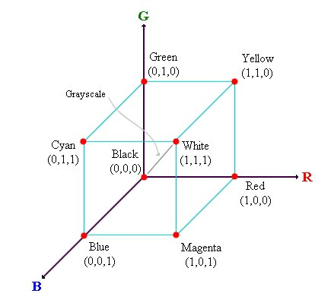
RGB Colour Model

Slide 41
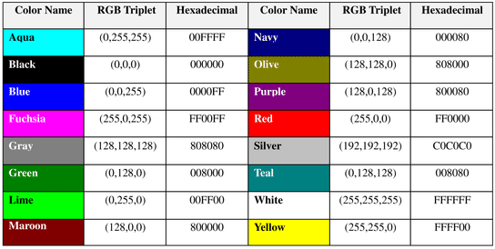
Basic Colours

Slide 42
Work with HTML documents in TextEdit on Mac
In the TextEdit app on your Mac, choose File > New, then choose Format > Make Plain Text.
Enter the HTML code.
Choose File > Save, type a name followed by the extension .html (for example, enter index.html), then click Save.
When prompted about the extension to use, click “Use .html”.

Slide 43
View an HTML document
In the TextEdit app on your Mac, choose TextEdit > Preferences, then click Open and Save.
Select “Display HTML files as HTML code instead of formatted text”.

Slide 44
Change how HTML files are saved
Set preferences that affect how HTML files are saved in TextEdit.
In the TextEdit app on your Mac, choose TextEdit > Preferences, then click Open and Save.
Below HTML Saving Options, choose a document type, a style setting for CSS and an encoding.

Slide 45
Change how HTML files are saved
Select “Preserve white space” to include code that preserves blank areas in documents.
If you open an HTML file and don’t see the code, TextEdit is displaying the file the same way a browser would (as formatted text).

Slide 46
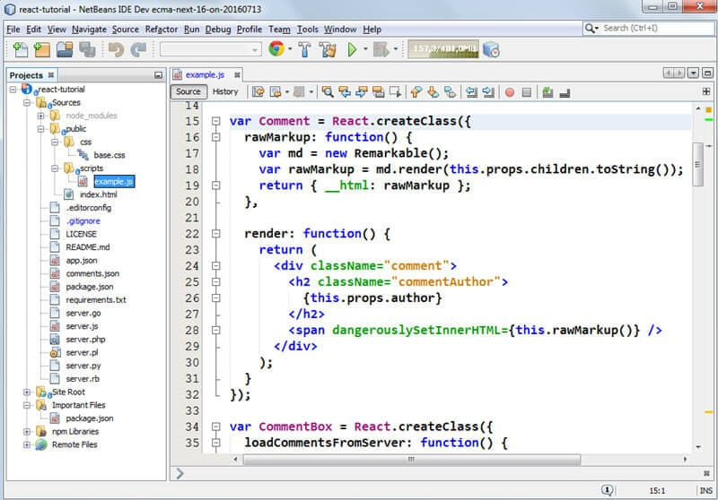
NetBeans
NetBeans is an open source IDE is used for developing software applications by developers. It can read and edit texts in HTML. PHP, C++ and a few more. It provides an intuitive user interface for macOS users and comes with customized key-bindings. Interestingly, it supports Git and management of source codes.

Slide 47
Sublime Text 2
Sublime Text 2 is the favorite of developers, because it can easily be completely customized to one’s own needs by using a JSON file. Moreover, there are several extensions to “stretch” the editor with. For example, a must-have extension is Package Control, which you can use to easily find and install extensions and plug-ins from right within the editor. To describe the full extent of features of Sublime Text 2 is rather difficult, as it can do, through its plug-ins and extensions, basically anything you need it to do.

Slide 48
Brackets
Brackets is a modern open source editor with several extremely interesting features. For example, when used in combination with Adobe Creative Cloud Extract (=preview) it can read design data such as colors, types, histories etc. directly from a PSD file and transform it into correct CSS code.

Slide 49
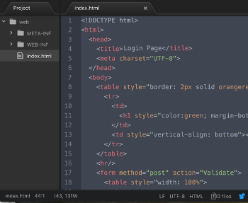
Atom
Atom is an open-source and free to use text and code editor with a rich set of plug-ins for different functions. It can be downloaded from Atom homepage, and it runs on Microsoft Windows, macOS, and Linux distributions. Atom highlights code written in many languages, including HTML, Java, Python, and others. Sample HTML code displayed in the Atom editor is shown in Figure

Slide 50
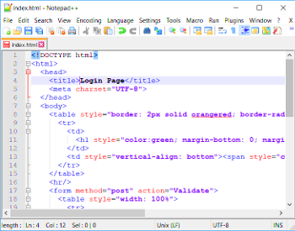
Notepad++
Notepad++ is a free-to-use editor that supports several programming languages. It runs on Microsoft Windows and doesn't have packages for other operating systems. You can download Notepad++ from Notepad++ home.

Slide 51
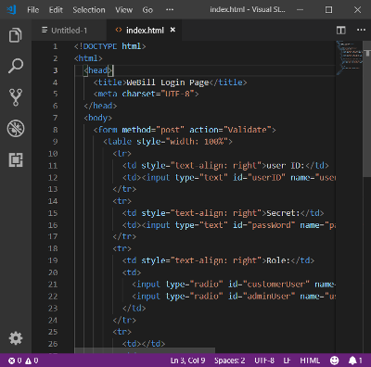
Visual Studio Code Editor
Visual Studio Code is another powerful editor that can assist you in writing and editing HTML, CSS, and JavaScript code, and has extensions for supporting other major programming languages. It is also free to use. You can try this editor in Visual Studio Code.
Figure shows you, its interface.

